Slide 1

Auxiliary memory: magnetic disks; Magnetic tapes
Computer Organization and Architecture | Memory & I/O Organization
Course: Computer Organization and Architecture | Chapter: Memory & I/O Organization | Program: Bachelor of Engineering
DISCOVER · LEARN · EMPOWER
Notes:
Welcome everyone to today's lecture on auxiliary memory. We will focus specifically on magnetic disks and tapes as critical components of the I/O organization. These devices form the backbone of our secondary storage systems in modern computing. Let us begin by understanding their fundamental roles.

Slide 2
Course Outcomes
SLIDE 2 / 10
Course Outcome
CO | BT LEVEL | DESCRIPTION
CO1 | BT3 | Apply number systems and digital logic to design basic digital circuits
CO2 | BT4 | Analyze register organization and instruction set architecture
CO3 | BT3 | Implement computer arithmetic algorithms and floating-point operations
CO4 | BT5 | Analyze memory hierarchy and input-output organization
CO5 | BT6 | Evaluate control unit design and pipelining performance
Chandigarh University
2 / 10
Notes:
Today's session is directly mapped to Course Outcome 4. You will learn to analyze how magnetic disks and tapes fit into the broader memory hierarchy. This analysis is crucial for understanding input-output organization in computer systems. By the end, you will be able to evaluate storage trade-offs effectively.

Slide 3
Learning Objectives
SLIDE 3 / 10
Learning Outcomes
1
Evaluate the structural differences between magnetic disks and tapes.
2
Analyze the performance metrics of sequential versus random access storage.
3
Calculate data transfer rates for magnetic tape operations.
4
Synthesize the role of auxiliary memory in the storage hierarchy.
5
Critique the suitability of tapes for archival versus disks for active use.
Chandigarh University
3 / 10
Notes:
By the end of this lecture, you will be able to evaluate the structural differences between these two media types. We will analyze how sequential access on tapes differs from the random access of disks. You will also calculate data transfer rates to understand performance bottlenecks. Finally, we will synthesize why both are still relevant in modern systems.

Slide 4
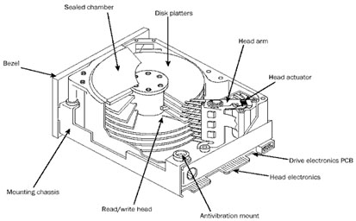
Lecture
SLIDE 4 / 10
Magnetic Disk Fundamentals
1
Disks store data on rotating platters coated with magnetic material.
2
Data is organized into concentric tracks and radial sectors.
3
A read-write head floats nanometers above the spinning surface.
4
Random access allows immediate retrieval of any specific data block.
5
Capacity is measured in gigabytes or terabytes of stored information.
How Hard Disk works, Internal structure and Read/Write data operations – Tech mastery
Chandigarh University
4 / 10
Notes:
Magnetic disks are the workhorses of modern computing. They store data on rotating platters where a read-write head floats just above the surface. Unlike tapes, disks allow random access, meaning you can jump to any sector instantly. This makes them ideal for operating systems and active applications.

Slide 5
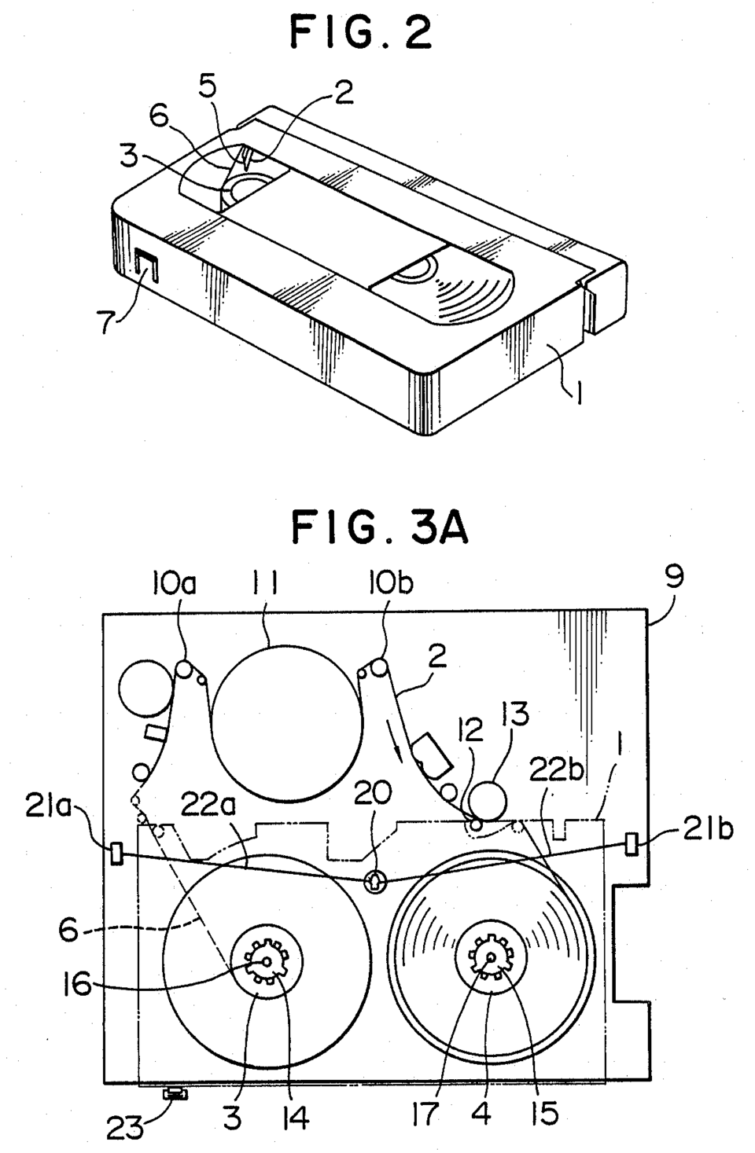
Lecture
SLIDE 5 / 10
Magnetic Tape Characteristics
1
Tapes store data linearly on a long strip of magnetic film.
2
Access is strictly sequential, requiring winding to reach specific data.
3
Tapes offer extremely high density and low cost per bit.
4
They are primarily used for backup and archival storage purposes.
5
Rewinding time can be significant for large data retrieval tasks.
Source: upload.wikimedia.org
Chandigarh University
5 / 10
Notes:
Magnetic tapes operate on a linear principle, storing data on a long strip of film. Access is strictly sequential, meaning you must wind the tape to reach specific data. While slower, they offer extremely high density and low cost per bit. This makes them the standard for long-term archival and backup strategies.

Slide 6
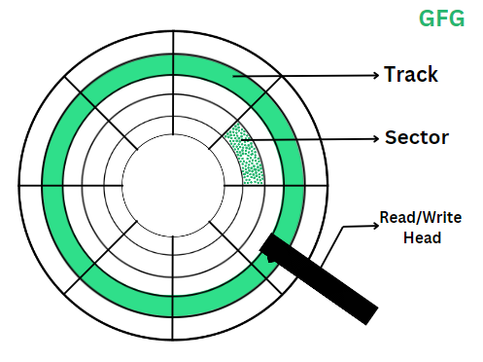
Lecture
SLIDE 6 / 10
Access Time Components
1
Access time equals seek time plus rotational latency plus transfer time.
2
Seek time is the delay moving the head to the correct track.
3
Rotational latency is the wait for the sector to rotate under the head.
4
Transfer time is the duration to read or write the actual data.
5
Tapes have negligible seek time but high latency for random access.
Source: media.geeksforgeeks.org
Chandigarh University
6 / 10
Notes:
Access time is the sum of seek time, rotational latency, and transfer time. Seek time is the delay moving the head to the correct track on the disk. Rotational latency is the wait for the sector to rotate under the head. Tapes differ significantly as they have negligible seek time but high latency for random access.

Slide 7
Numerical Example
SLIDE 7 / 10
Disk Transfer
GOVERNING EQUATION
Rotational latency = 60 seconds / (2 × 3000) = 0.01 seconds
1
Assume a disk with 100 sectors per track and 3000 RPM speed.
2
Transfer time for one sector = 1 / 3000 = 0.00033 seconds.
3
Total time for one sector = Seek + 0.01 + 0.00033 seconds.
4
This shows why random access is fast compared to sequential winding.
Source: media.geeksforgeeks.org
Chandigarh University
7 / 10
Notes:
Let's calculate the rotational latency for a disk spinning at 3000 RPM. The formula is 60 divided by twice the RPM, giving us 0.01 seconds. Transfer time for one sector is roughly 0.00033 seconds. This calculation demonstrates why random access is fast compared to the winding required for tapes.

Slide 8
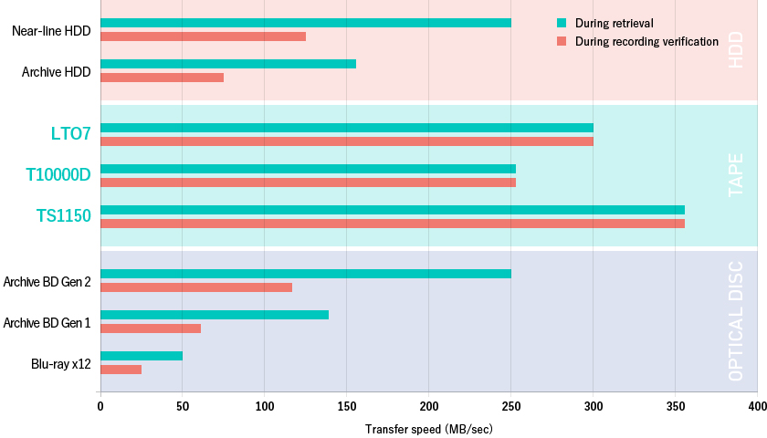
Lecture
SLIDE 8 / 10
Performance Comparison
1
Disks provide random access with millisecond response ×.
2
Tapes provide sequential access with minute-level response ×.
3
Disks have higher cost per gigabyte than magnetic tapes.
4
Tapes have lower power consumption during idle storage periods.
5
Disks are better for online systems; tapes for offline archives.
Source: www.tape-storage.net
Chandigarh University
8 / 10
Notes:
Disks provide random access with millisecond response ×, making them fast. Tapes provide sequential access with minute-level response ×, which is much slower. Disks have a higher cost per gigabyte than magnetic tapes. However, tapes have lower power consumption during idle storage periods.

Slide 9
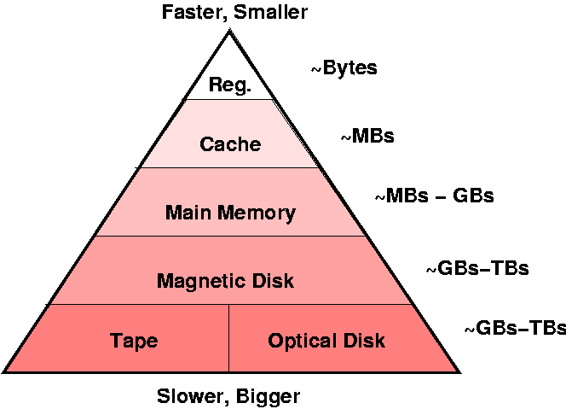
Lecture
SLIDE 9 / 10
Key Takeaways
1
Disks use rotating platters for random access to data blocks.
2
Tapes use linear strips for sequential access to data streams.
3
Access time includes seek, latency, and transfer components.
4
Tapes are cost-effective for archival; disks for active processing.
5
Understanding these differences is vital for memory hierarchy design.
Source: users.cs.fiu.edu
Chandigarh University
9 / 10
Notes:
To summarize, disks use rotating platters for random access to data blocks. Tapes use linear strips for sequential access to data streams. Access time includes seek, latency, and transfer components. Tapes are cost-effective for archival while disks are for active processing.

Slide 10
Lecture
SLIDE 10 / 10
References
COMPUTER ORGANIZATION AND DESIGN
The Hardware/Software Interface — David A. Patterson, John L. Hennessy
COMPUTER ARCHITECTURE
A Quantitative Approach — John L. Hennessy, David A. Patterson
• Computer Organization and Architecture — William Stallings
• Computer System Architecture — M. Morris Mano & Rajib Mall
• Computer Organization — Carl Hamacher, Zvonko Vranesic, Safwat Zaky
Chandigarh University
10 / 10
Notes:
These five textbooks provide the foundational knowledge for today's lecture. William Stallings and M. Morris Mano offer detailed architectural insights. Carl Hamacher and the team of Patterson and Hennessy provide quantitative approaches. Please refer to these texts for deeper study on memory organization.

